Slide 1
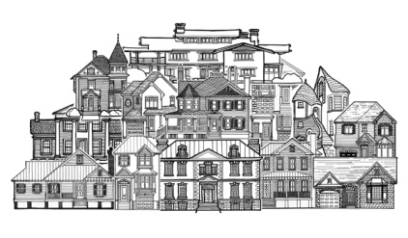
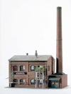
Northern Water Treatment Plant
Oyster Bay pumping station
Corio west pumping station
Shell spent caustic
Shell trade waste
Ultra Filtration Plant
Shell fire system
Chlorine contact tank
Type 2 storage tank
Bio treater
Strainer
ULTRA FILTRATION
UV Disinfection
Flow balance tank
Stead Park irrigation
UF backwash
UF effluent
Neutralisation pit
Type 3 storage tank
SEWER
to Blackrock
Waste pit
RO effluent
Reverse Osmosis Filtration Plant
Type 1 storage tank
RO concentrate tank
Chlorine contact tank
R.O. FILTRATION
CO2 Degasser
RO Permeate tank
Shell boilers

Slide 2
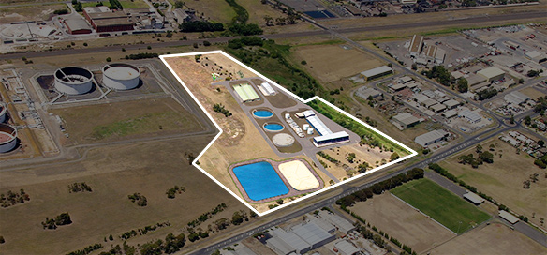
Northern Water Treatment Plant

