Slide 1
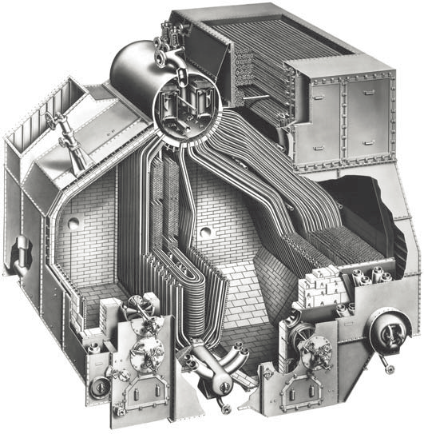
USS ORLECK
DD-886
There are 2 firerooms, each with 2 Babcock & Wilcox “Express” water tube steam boilers. The steam is generated at 675 psi by 4 oil burners, then superheated to 875 degrees by further heating in a separate furnace with 3 more oil burners, with steaming rates controlled by changing the number of burners in each side to accurately give the correct flow and temperature required in the engine rooms.
BABCOCK & WILCOX twin furnace steam boiler
Feedwater economiser
Hot gasses and smoke
Steam drum
A crew of 4 men manually control fans, burners and other auxiliaries in this hot space, typically running around 110 F!
Fan forced Combustion air
Each fireroom acts directly with its associated engineroom but piping can be cross connected maintaining reliability in cases of combat damage control or mechanical breakdown.
Air for combustion is fan forced into an outer casing which surrounds the boiler membrane water walls, keeping the fire room cooler while pre-heating the air which flows to the windbox at the boiler front before entering with the burners.
Steam generating tubes
Super heater tubes divide the 2 furnaces and are covered by steam generating tubes to shield the superheater from the high radiant heat from the burning oil.
Superheater tubes
Steam furnace
Radiant heat screen
Boiler feedwater is warmed and stripped of oxygen before it is further heated by hot flue gases leaving the furnace in the economiser. Steam nozzles are strategically fitted into the tight spaces around these high heat transfer finned tubes to blow clean any soot build up from the flue gasses.
Superheater
furnace
The water circulates by convection with the cooler water falling to supply the generating tubes through larger downcomers, water wall headers and the water drum. Steam bubbles help promote the rapid rise back to the steam drum aiding the circulation process.
Superheater
oil burners
Waterwall header
Water drum
The steam and water mixture returning to the steam drum enters behind a baffle plate which forces it through patented
“Cyclone Steam separators” which causes a vortex where the water clings to the separator walls falling down, allowing a clear path in the center for the steam to break freely away in all conditions regardless of sloshing around in rough seas.
Main furnace
oil burners

