Slide 1
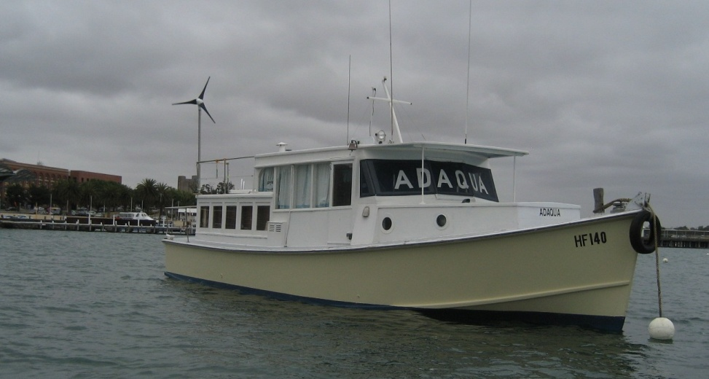
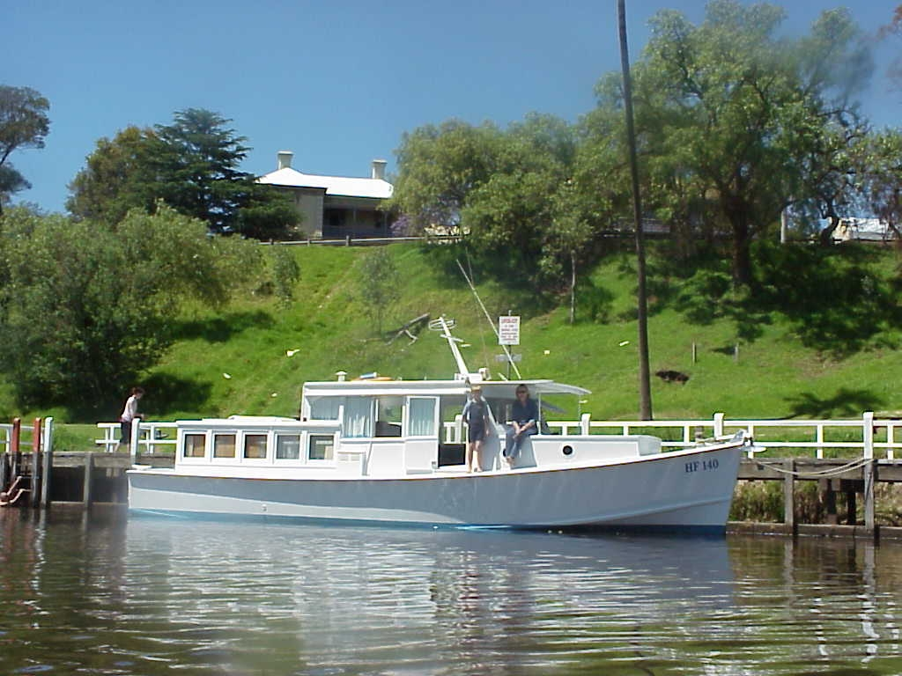
ADAQUA
She was built in 1943 by “Spring & Denaro” boat builders, Breakfast Creek Brisbane, during a wartime program to build boats for use with the Royal Australian Airforce to assist with their Catalina flying boat program. These boats became surplus to requirements at the war’s end and were instead delivered to public service roles where required.
Adaqua was pressed into service with the Brisbane River division of the Australian Customs service, for use in checking the ships arriving and departing Brisbane after the war. Later she was brought for use as a charter boat on the Gippsland Lakes, Victoria before being sold for private use to Mr. David Clandinanan who had the boat for many years. Adaqua was purchased in 2003 by Mark Dye as a private launch, and after a year in Gippsland was moved to Geelong Victoria.
In the rear cabin, can be seen 2 cabinets which are used to store crockery and food stuffs. If you look in the top of these cupboards, you can still see the rod used by the customs officers to hang up their uniform jackets!

Slide 2
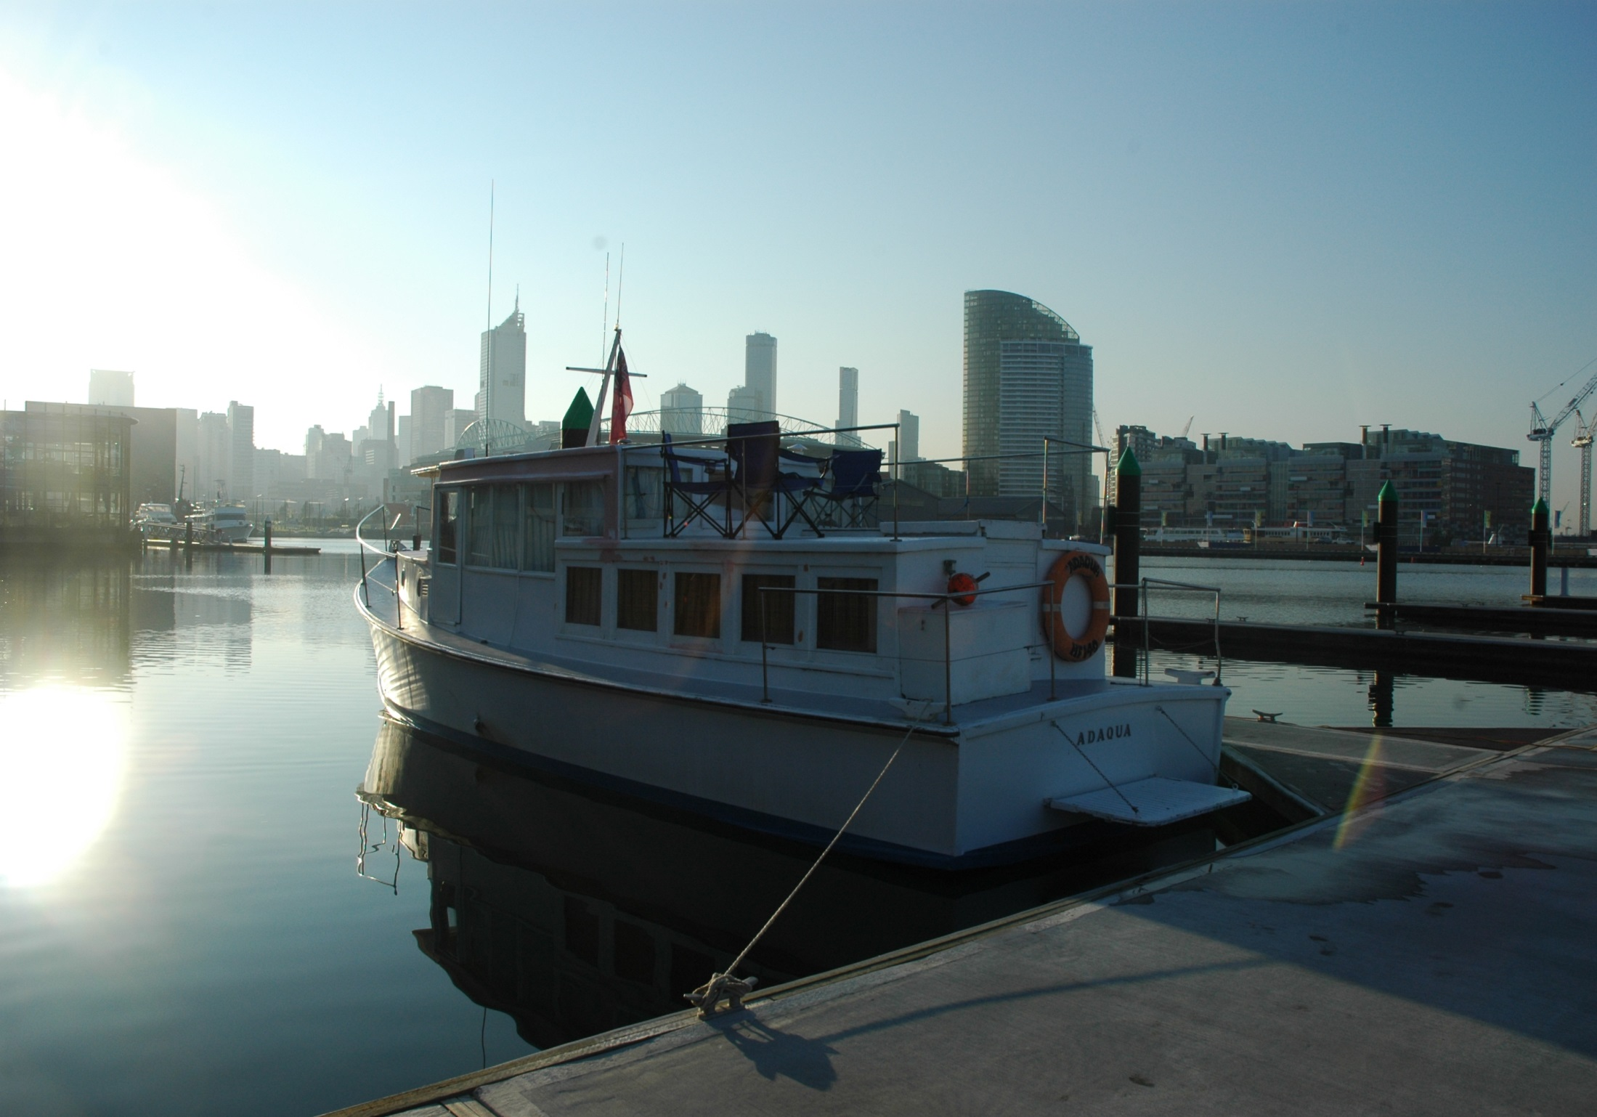
DOCKLANDS MELBOURNE

Slide 3
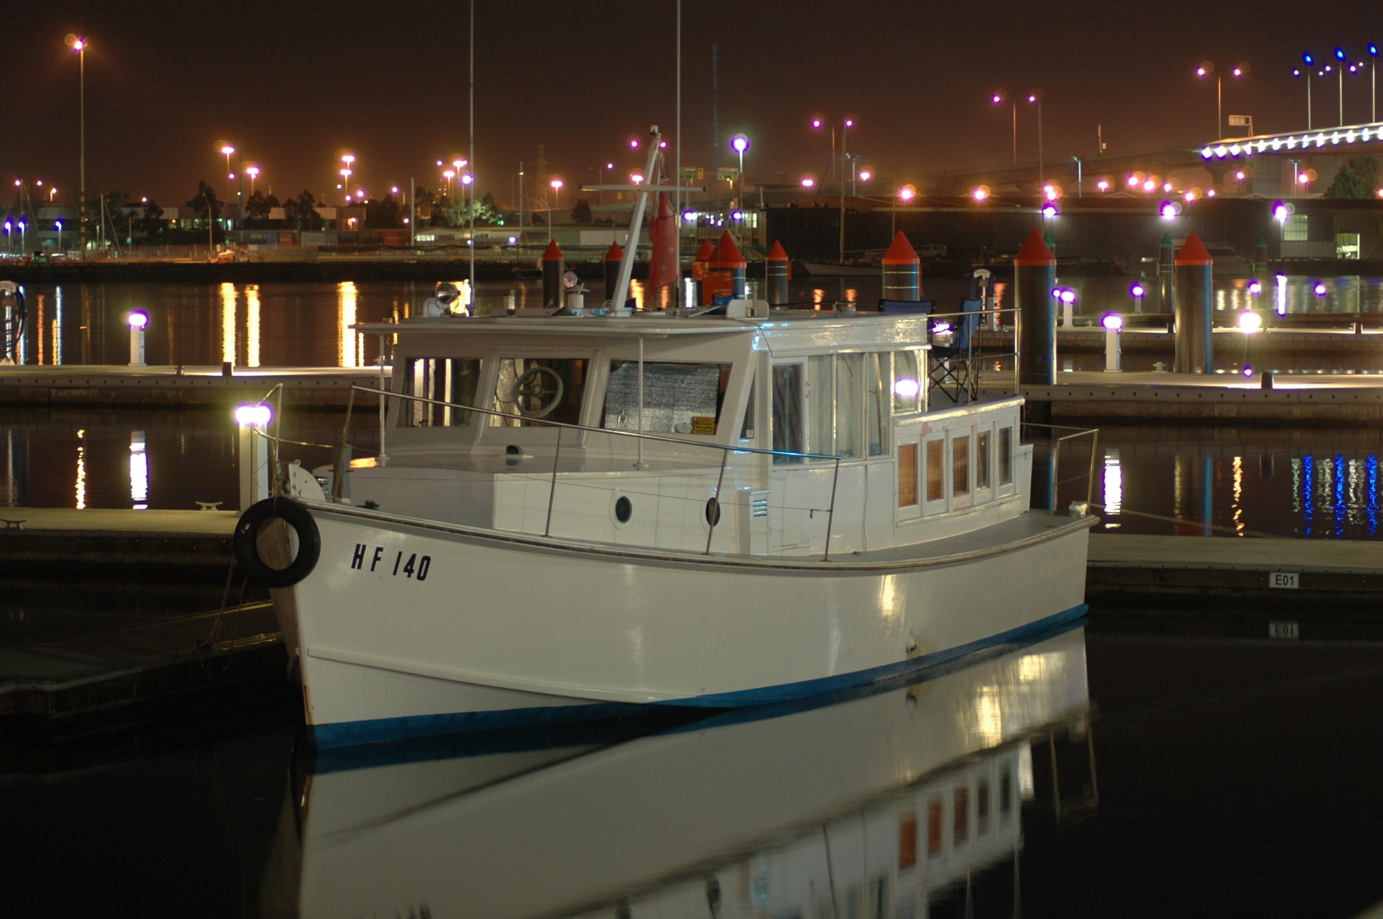
DOCKLANDS MELBOURNE

Slide 4
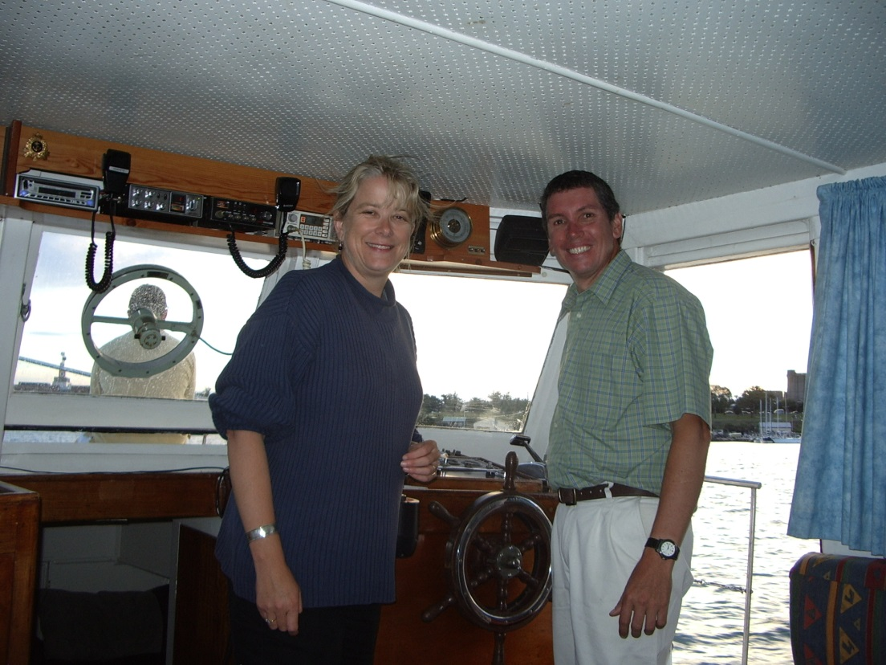
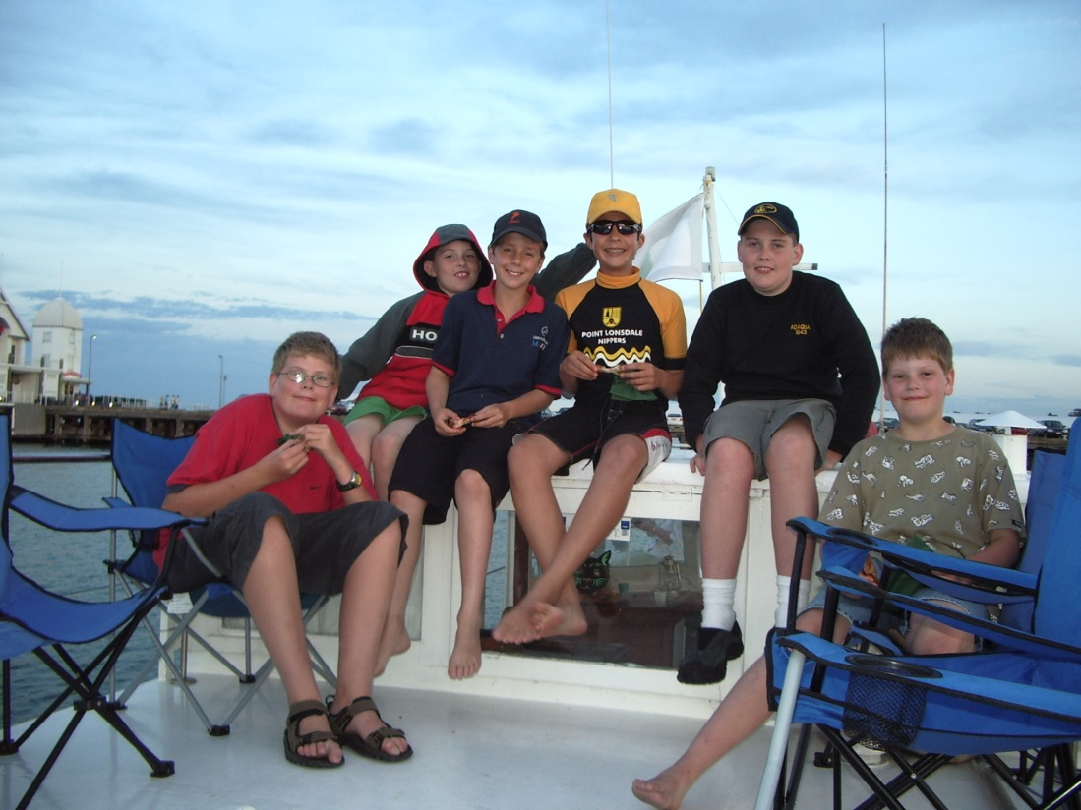
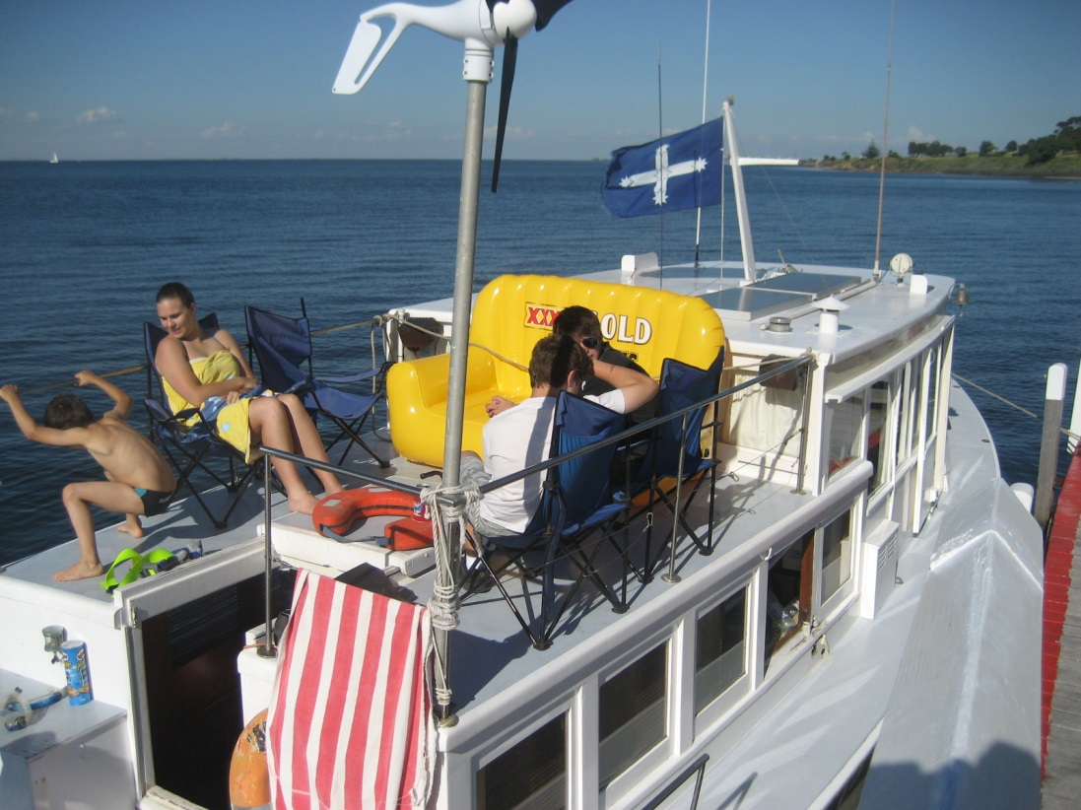
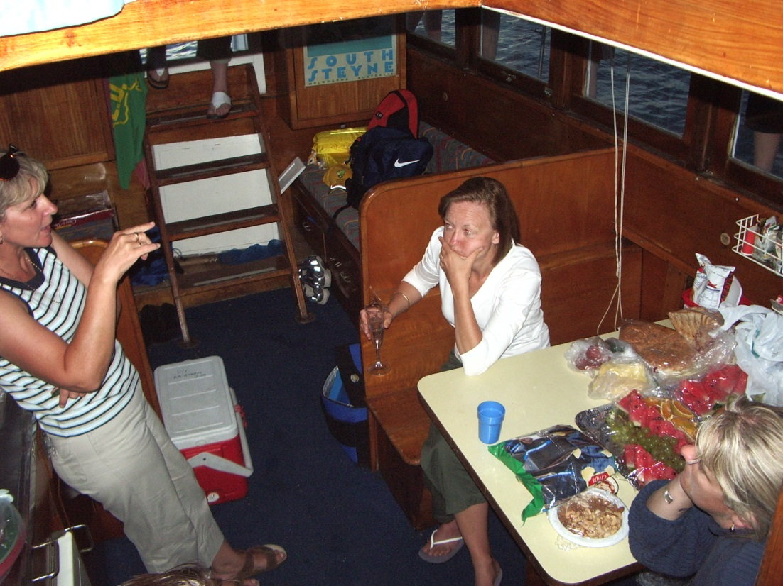

Slide 5
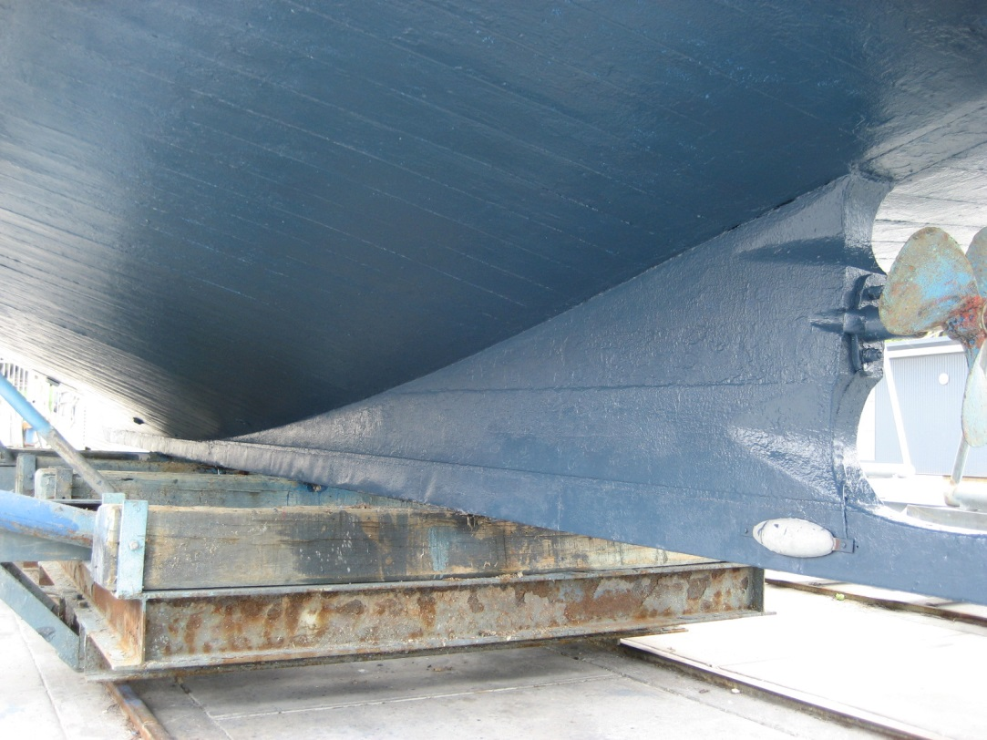
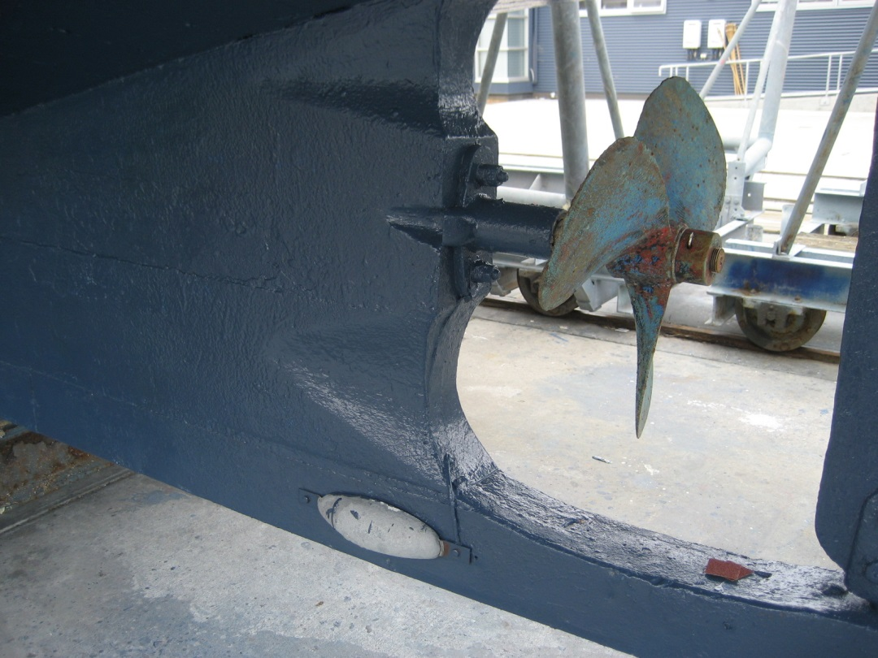
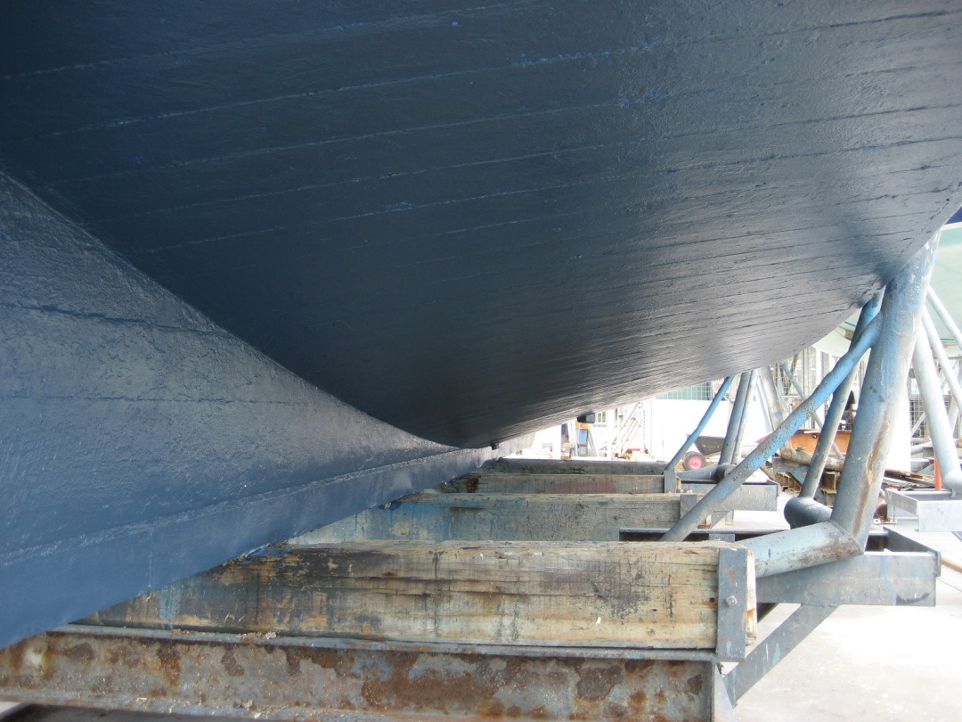
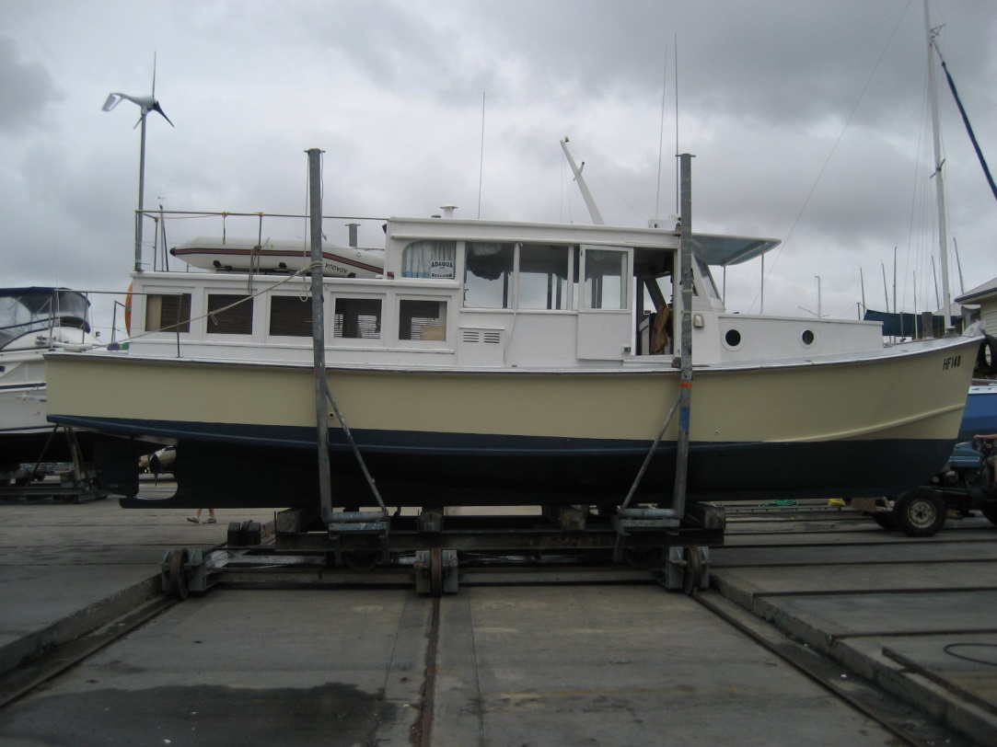

Slide 6
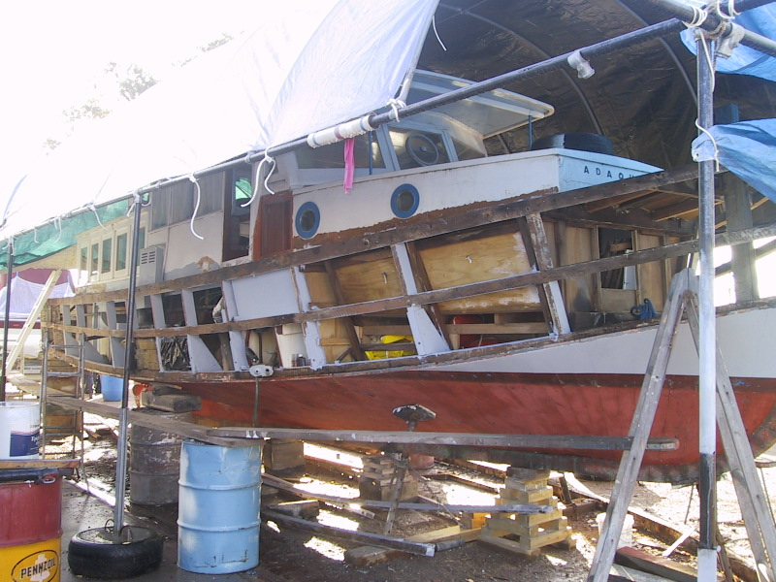
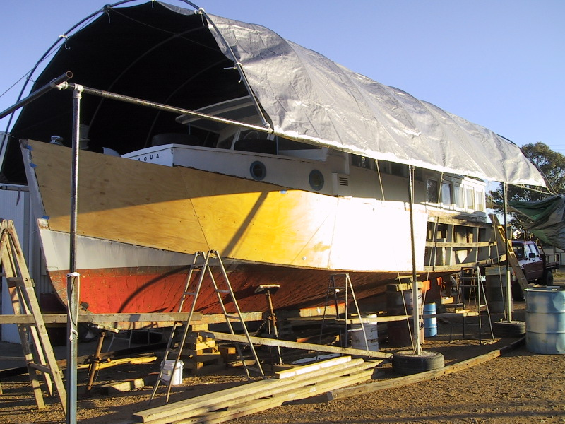
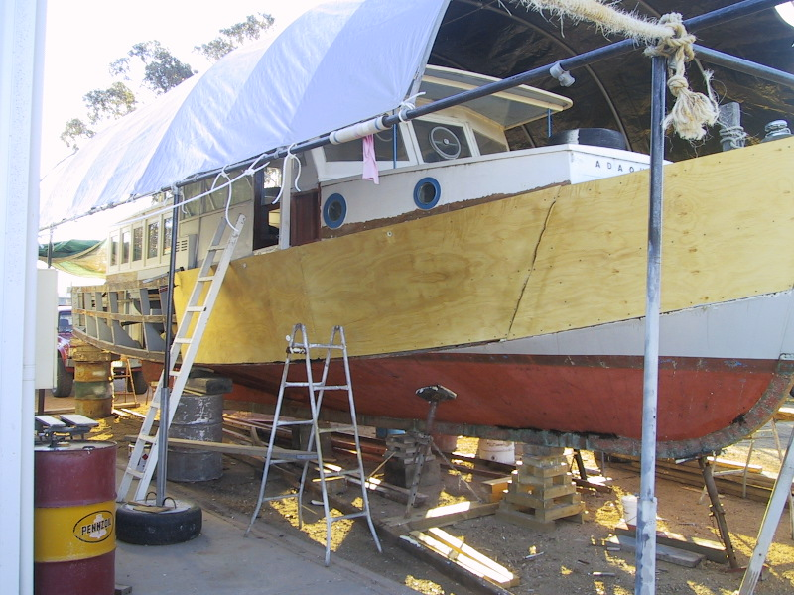
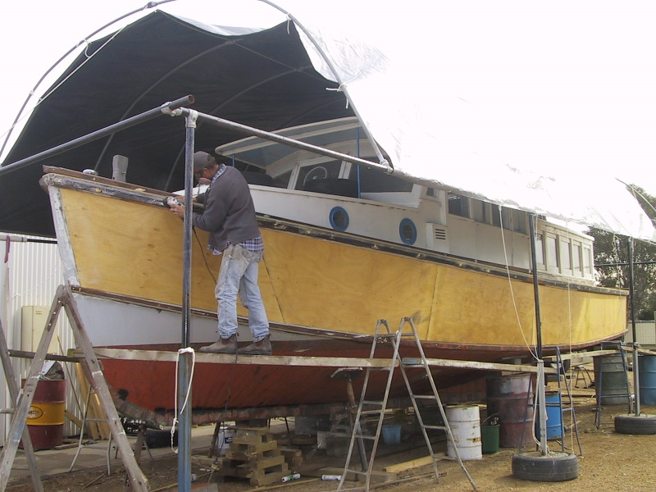
ADAQUA Hull restoration 2003

